Slide 1
Make Your Own Personal Website
Harry Li
Assistant Staff, MIT Lincoln Laboratory

Slide 2

Why have a personal website?
More attractive than a resume
Easier to show an employer
Helps you stand out from other candidates

Slide 3
1) Template Site
Start with a premade site: tiny.cc/pw-code
Example: tiny.cc/pw-example
No programming experience required
Fill in your own information

Slide 4
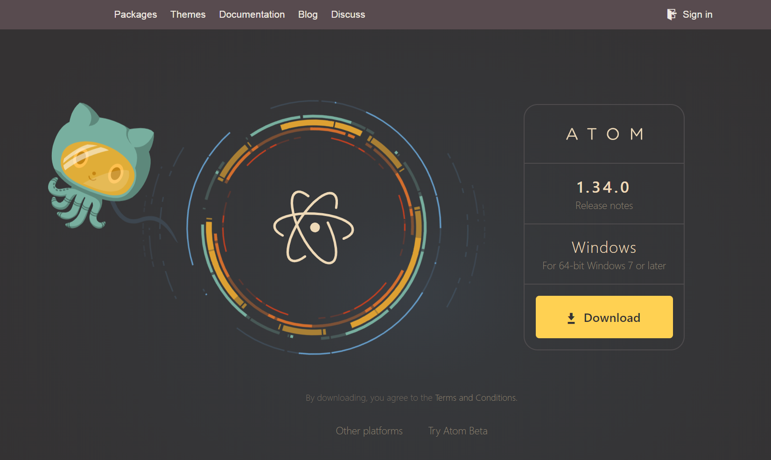
Text Editor
Atom
atom.io
Place your screenshot here

Slide 5
Cloud
Pay a company for computing services
Storage, computing power, website hosting
Google Docs – create and store documents with Google
We buy cars; we buy computing services

Slide 6

Amazon Web Services
Domains (optional) - $12 / year
Static website hosting - $0.01 / month
Routing (optional) - $0.50 / month
----------------------------------------------
$18.12 / year
Make an AWS account (must provide credit card)

Slide 7
2) Buy a domain (optional)
Amazon Route 53

Slide 8
3) Upload Your Site to AWS S3
Simple cloud Storage Service
Super cheap
Upload website files
Make your files public
Static website hosting

Slide 9
4) Routing (optional)
Point your domain to your S3 website files

